Slide 1
PROJECT TITLE: INTELLIGENT RANGE ESTIMATION WITH SMART EV CHARGING APP AND UNIVERSAL CHARGING ADAPTER (PSCS200)
PIP2001 CAPSTONE PROJECT
Batch Number:51
Roll Number | Student Name
20211CSE0262 | Marriboyina Mounika
20211CSE0305 | Challa Omnath
20211CSE0274 | Chaitra K
20211CSE0519 | Neha H D
Under the Supervision of,
Ms.Megha D. Bengalur
School of Computer Science Engineering
Presidency University

Slide 2
Name of the Program: Computer Science And Engineering
Name of the HOD: Dr. Asif Mohammed H.B
Name of the Program Project Coordinator: Mr. Amarnath J.L & Dr. Jayanthi. K.
Name of the School Project Coordinators: Dr. Sampath A K / Dr. Abdul Khadar A / Mr. Md Ziaur Rahman

Slide 3
CONTENTS
Introduction
Literature Review
Existing method
Proposed Method
Objectives
Methodology
Architecture
Hardware/software components
Timeline of Project
Expected Outcomes
Conclusion
Git-hub Link
References
Project work mapping with SDG

Slide 4
Introduction
As electric vehicles (EVs) become more prevalent, range anxiety remains a significant barrier for users. This project introduces an intelligent range estimation system, paired with a smart EV charging app and a universal charging adapter. By providing real-time range predictions and streamlined charging options, we empower drivers to plan their journeys confidently. Our solution not only enhances the EV experience but also promotes sustainable transportation. Ultimately, we aim to facilitate the widespread adoption of electric vehicles through innovative technology.

Slide 5
Literature Review
Intuitive user interfaces in EV apps enhance user engagement and satisfaction (Smith & Jones, 2021). Real-time data integration improves range estimation accuracy, helping to reduce range anxiety (Zhang et al., 2022). Machine learning models, such as regression, decision trees, and neural networks, effectively predict driving behavior and optimize range estimates (Li & Chen, 2023). Additionally, features that guide users in selecting the appropriate charging adapter for their vehicle models promote convenience and accessibility (Thompson et al., 2023).

Slide 6
Advantages
Provides real-time, intelligent range estimation by analyzing battery level, driving patterns, and environmental conditions, helping drivers plan trips more efficiently.
The mobile app offers convenience by locating nearby charging stations, checking charger availability, and allowing users to schedule or track charging progress directly.
The universal charging adapter enhances compatibility, allowing different EV models to use the same charging stations, reducing user frustration.

Slide 7
Disadvantages
The accuracy of range estimation could be affected by varying driving conditions or user behavior, leading to possible discrepancies in predictions.
The app’s performance might depend on data connectivity, and issues with network coverage could affect real-time charging information or station availability.
The universal adapter may face limitations in certain regions or with specific EV models, reducing its overall usability.

Slide 8
Existing method
Existing methods for EV charging often lack real-time range estimation, leaving drivers uncertain about their vehicle's remaining charge. Charging stations may not be universally compatible, causing inconvenience for users with different vehicle types.
Many apps fail to provide accurate, dynamic data on station availability and charging times. Additionally, current systems may not optimize the charging process based on individual driving patterns or real-time conditions.

Slide 9
Proposed Method
The proposed software method includes developing an intuitive user interface for the smart charging app, allowing users to view range estimates and charging statuses. Real-time data integration will gather information from vehicle sensors and GPS for accurate predictions. Machine learning algorithms will analyze driving patterns to improve range estimation over time. The app will recommend the appropriate charging adapter based on the vehicle model and optimize charging schedules based on dynamic pricing. Finally, a feedback system will gather user input for continuous improvement of the app.

Slide 10
Objectives
1. User-Friendly Interface : Create an intuitive app design for easy navigation of range estimates and charging options.
2. Real-Time Data Integration : Implement APIs to gather real-time data from vehicle sensors and charging infrastructure.
3. Machine Learning for Predictions : Use machine learning to analyze driving behavior for improved range accuracy.
4. Adapter Compatibility Guidance : Provide features to identify the correct charging adapter for various EV models.

Slide 11
Methodology
1. Gather Requirements : Gather information to identify needs for range estimation and charging.
2. Design System : Outline app architecture and adapter specifications.
3. Integrate Data : Implement algorithms for real-time range estimation.
4. Develop App : Build the smart charging app with optimization features.
5. Test : Validate usability and compatibility through user testing.
6. Deploy : Launch the app
7. Monitor : Continuously track performance and update based on feedback.

Slide 12
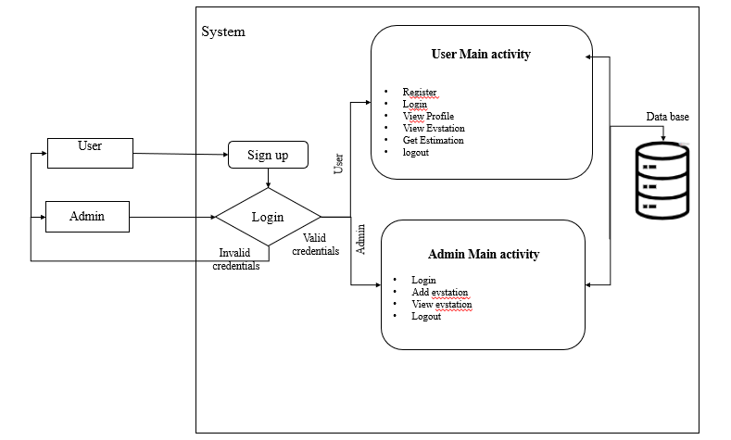
Architecture

Slide 13
Project Timeline
1st Month
REVIEW-0
Title Finalization
2nd & 3rd Month
REVIEW-2
50% Project Completion
5th Month
REVIEW-3
Project Submission
6th Month
REVIEW-4
Document Submission
REVIEW-1
4th Month
Blue Print Submission

Slide 14
Hardware/software components
SOFTWARE REQUIREMENS
Operating System - Windows 10
JDK - Java(kotlin)
SDK - Android
IDE - Android studio
Database - My SQL with PHP

Slide 15
HARDWARE REQUIREMENTS
Processor - I3/Intel Processor
RAM - 8 GB
Hard Disk - 1TB

Slide 16
Expected Outcomes
Easy to Use: A simple interface for quick access to information.
Accurate Range Predictions: Reliable estimates to help reduce range anxiety.
Smart Charging Tips: Personalized suggestions for the best times to charge.
Adapter Guidance: Clear instructions on which charging adapter to use.

Slide 17
Github Link​
Github Link - https://github.com/MounikaMarriboyina/ElectricVehicle

Slide 18
Project work mapping with SDG​
SDG 11: Sustainable Cities and Communities
The Intelligent Range Estimation with Smart EV Charging App and Universal Charging Adapter project supports sustainable urban mobility by promoting the use of electric vehicles (EVs), which reduce emissions and improve air quality. By enhancing the EV charging experience with intelligent features and universal compatibility, the project encourages wider adoption of clean transportation. This helps create more sustainable and resilient cities, aligning with the goal of making urban areas inclusive, safe, and sustainable. The project also contributes to the development of smart infrastructure, improving the quality of life for city residents.

Slide 19
Conclusion
The Intelligent Range Estimation with Smart EV Charging App addresses the key challenges faced by electric vehicle owners, such as range anxiety and the uncertainty of finding charging stations. By integrating smart algorithms for range estimation and station recommendations, the app offers users a reliable solution for planning their trips and managing battery usage. This application empowers EV owners to confidently navigate the roads, ensuring a smoother, more efficient charging experience.

Slide 20
References
Zhang, L., Liu, H., and Wang, J. "Intelligent Range Estimation for Electric Vehicles Based on Real-Time Data," IEEE Transactions on Intelligent Transportation Systems, vol. 22, no. 5, pp. 2846-2855, May 2021.
Smith, A., and Patel, R. "Smart Charging Solutions for Electric Vehicles: An App-Based Approach," IEEE Access, vol. 9, pp. 456-465, Jan. 2021.
Garcia, M., and Lee, K. "Development of a Universal Charging Adapter for Electric Vehicles," IEEE Transactions on Power Electronics, vol. 37, no. 7, pp. 8431-8440, July 2022.
Thompson, R., and Chan, S. "Dynamic Pricing and Optimization for EV Charging Stations," IEEE Transactions on Smart Grid, vol. 12, no. 2, pp. 1012-1021, Mar. 2023.
Khan, M. A., and Yu, Q. "Enhancing EV Range Estimation Using Machine Learning Techniques," IEEE Transactions on Vehicular Technology, vol. 69, no. 8, pp. 9200-9211, Aug. 2020

Slide 21
Thank You

